Slide 1
JavaScript by : Parul Madan(AP) GEU

Slide 2
What is JavaScript?
JavaScript is a lightweight, interpreted programming language.
Designed for creating network-centric applications.
Complementary to and integrated with Java.
Complementary to and integrated with HTML.
Open and cross-platform

Slide 3
Why to Learn JavaScript?
Javascript is the most popular programming language in the world and that makes it a programmer’s great choice. Once you learnt Javascript, it helps you developing great front-end as well as back-end softwares using different Javascript based frameworks like jQuery, Node.JS etc.
Javascript is everywhere, it comes installed on every modern web browser and so to learn Javascript you really do not need any special environment setup. For example Chrome, Mozilla Firefox , Safari and every browser you know as of today, supports Javascript.
JavaScript usage has now extended to mobile app development, desktop app development, and game development. This opens many opportunities for you as Javascript Programmer.
Great thing about Javascript is that you will find tons of frameworks and Libraries already developed which can be used directly in your software development to reduce your time to market.

Slide 4
Syntax
<html>
<body>
<script language = "javascript" type = "text/javascript">
<!--
document.write("Hello World!")
//-->
</script>
</body>
</html>

Slide 5
There are many useful Javascript frameworks and libraries available:
Angular
React
jQuery
Node.js
Polymer
Aurelia
Backbone.js

Slide 7
Applications of Javascript Programming
Client side validation - This is really important to verify any user input before submitting it to the server and Javascript plays an important role in validting those inputs at front-end itself.
Manipulating HTML Pages - Javascript helps in manipulating HTML page on the fly. This helps in adding and deleting any HTML tag very easily using javascript and modify your HTML to change its look and feel based on different devices and requirements.
User Notifications - You can use Javascript to raise dynamic pop-ups on the webpages to give different types of notifications to your website visitors.
Back-end Data Loading - Javascript provides Ajax library which helps in loading back-end data while you are doing some other processing. This really gives an amazing experience to your website visitors.

Slide 8
Applications of Javascript Programming contd..
Presentations - JavaScript also provides the facility of creating presentations which gives website look and feel. JavaScript provides RevealJS and BespokeJS libraries to build a web-based slide presentations.
Server Applications - Node JS is built on Chrome's Javascript runtime for building fast and scalable network applications. This is an event based library which helps in developing very sophisticated server applications including Web Servers.

Slide 9
Client-Side JavaScript
Client-side JavaScript is the most common form of the language. The script should be included in or referenced by an HTML document for the code to be interpreted by the browser.
It means that a web page need not be a static HTML, but can include programs that interact with the user, control the browser, and dynamically create HTML content.
The JavaScript client-side mechanism provides many advantages over traditional CGI server-side scripts. For example, you might use JavaScript to check if the user has entered a valid e-mail address in a form field.
The JavaScript code is executed when the user submits the form, and only if all the entries are valid, they would be submitted to the Web Server.
JavaScript can be used to trap user-initiated events such as button clicks, link navigation, and other actions that the user initiates explicitly or implicitly.

Slide 10
Advantages of JavaScript
Less server interaction − You can validate user input before sending the page off to the server. This saves server traffic, which means less load on your server.
Immediate feedback to the visitors − They don't have to wait for a page reload to see if they have forgotten to enter something.
Increased interactivity − You can create interfaces that react when the user hovers over them with a mouse or activates them via the keyboard.
Richer interfaces − You can use JavaScript to include such items as drag-and-drop components and sliders to give a Rich Interface to your site visitors.

Slide 11
Disadvantages of Javascript
Client-side JavaScript does not allow the reading or writing of files. This has been kept for security reason.
JavaScript cannot be used for networking applications because there is no such support available.
JavaScript doesn't have any multi-threading or multiprocessor capabilities.

Slide 12
Comments in JavaScript
Any text between a // and the end of a line is treated as a comment and is ignored by JavaScript.
Any text between the characters /* and */ is treated as a comment. This may span multiple lines.
JavaScript also recognizes the HTML comment opening sequence <!--. JavaScript treats this as a single-line comment, just as it does the // comment.
The HTML comment closing sequence --> is not recognized by JavaScript so it should be written as //-->.
<script language = "javascript" type = "text/javascript">
<!--
// This is a comment. It is similar to comments in C++
/*
* This is a multi-line comment in JavaScript
* It is very similar to comments in C Programming
*/
//-->
</script>

Slide 13
Warning for Non-JavaScript Browsers
<html>
<body>
<script language = "javascript" type = "text/javascript">
<!--
document.write("Hello World!")
//-->
</script>
<noscript>
Sorry...JavaScript is needed to go ahead.
</noscript>
</body>
</html>

Slide 14
JavaScript in External File
<html>
<head>
<script type = "text/javascript" src = "filename.js" ></script>
</head>
<body>
.......
</body>
</html>

Slide 15
JavaScript Datatypes
JavaScript allows you to work with three primitive data types −
Numbers, eg. 123, 120.50 etc.
Strings of text e.g. "This text string" etc.
Boolean e.g. true or false.

Slide 16
Declaration and initialization of Variables
<script language = "javascript" type = "text/javascript">
<!--
var1 = 10
var2 = 20
//-->
</script>

Slide 17
JavaScript Variable Scope
Global Variables − A global variable has global scope which means it can be defined anywhere in your JavaScript code.
Local Variables − A local variable will be visible only within a function where it is defined. Function parameters are always local to that function.
<html>
<body onload = checkscope();>
<script type = "text/javascript">
<!--
var myVar = "global"; // Declare a global variable
function checkscope( ) {
var myVar = "local"; // Declare a local variable
document.write(myVar);
}
//-->
</script>
</body>
</html>

Slide 18
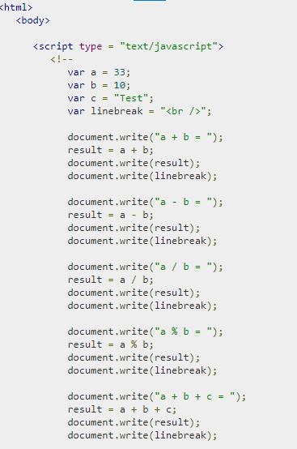
e.g.

Slide 19
If-else condition
<html>
<body>
<script type = "text/javascript">
<!--
var age = 20;
if( age > 18 ) {
document.write("<b>Qualifies for driving</b>");
} else {
document.write("<b>Does not qualify for driving</b>");
}
//-->
</script>
<p>Set the variable to different value and then try...</p>
</body>
</html>

Slide 20
Switch Case
<html>
<body>
<script type = "text/javascript">
<!--
var grade = 'A';
document.write("Entering switch block<br />");
switch (grade) {
case 'A': document.write("Good job<br />");
break;
case 'B': document.write("Pretty good<br />");
break;
default: document.write("Unknown grade<br />")
}
document.write("Exiting switch block");
//-->
</script>
<p>Set the variable to different value and then try...</p>
</body>
</html>

Slide 21
For loop
<html>
<body>
<script type = "text/javascript">
<!--
var count;
document.write("Starting Loop" + "<br />");
for(count = 0; count < 10; count++) {
document.write("Current Count : " + count );
document.write("<br />");
}
document.write("Loop stopped!");
//-->
</script>
<p>Set the variable to different value and then try...</p>
</body>
</html>

Slide 22
The while Loop
<html>
<body>
<script type = "text/javascript">
<!--
var count = 0;
document.write("Starting Loop ");
while (count < 10) {
document.write("Current Count : " + count + "<br />");
count++;
}
document.write("Loop stopped!");
//-->
</script>
<p>Set the variable to different value and then try...</p>
</body>
</html>

Slide 23
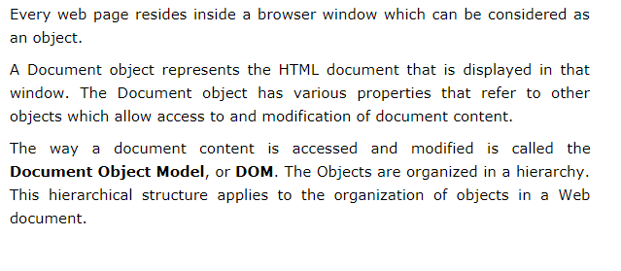
Document Object Model

Slide 24
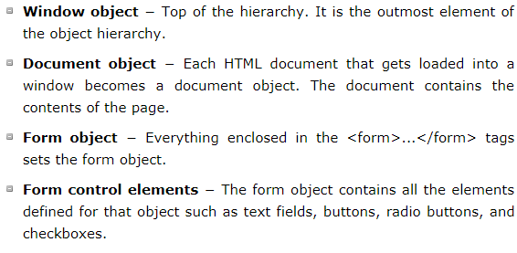

Slide 25
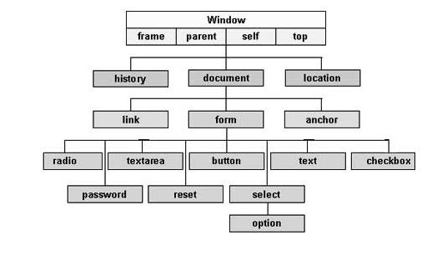

Slide 26
Methods of Document object
write() | Writes HTML expressions or JavaScript code to a document
writeln() | Same as write(), but adds a newline character after each statement
open() | Opens an HTML output stream to collect output from document.write()
close() | Closes the output stream previously opened with document.open()
getElementById() | Returns the element that has the ID attribute with the specified value
getElementsByClassName() | Returns a HTMLCollection containing all elements with the specified class name
getElementsByName() | Returns a HTMLCollection containing all elements with a specified name
getElementsByTagName() | Returns a HTMLCollection containing all elements with the specified tag name

